Slide 1
Diffusion:
Contagion or Equivalence

Slide 2
Burt’s positional equivalence model
Reanalysis of Coleman et. al. (1957, 1966) study of diffusion of a new drug, tetracycline
Coleman claimed that diffusion patterns indicative of contagion
Burt hypothesized that structural equivalence could explain diffusion pattern
  Study
    4 Illinois cities
    130 (of 152, 85%) general practitioners, internists, pediatricians (and 4 specialists)
    pharmacy records used to code when physician first prescribed tetracycline
    network data from 2 name generators (advice and discuss) in physician surveys

Slide 3
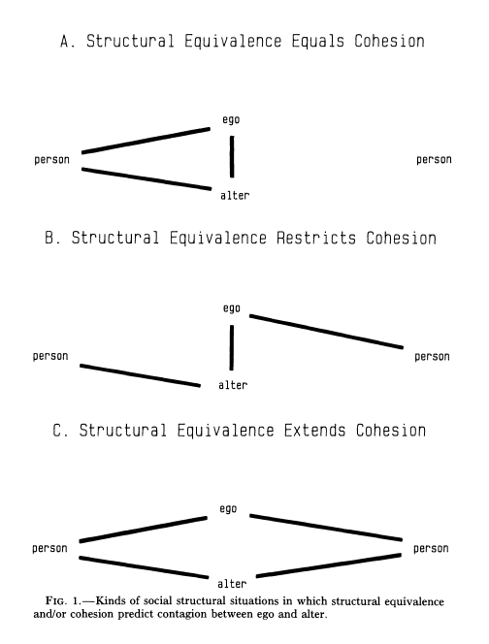
Cohesion (influence) vs. Equivalence (similarity)
Both Equivalence (similar relations with same people) and Cohesion (via strong tie between ego and alter) predict diffusion
  Cohesion but not Equivalence predicts restricted contagion (because of conflicting affiliations)
  Equivalence predicts contagion via competition for status
Mechanisms:
  Physical proximity: can "see" alters behaviors
    Cohesion: communication, social proximity
  Competition, relative standing: structural equivalence
    2 similar physicians keeping up with each other

Slide 4

Diffusion or Contagion?
k = probability of adopting independently
y = proportion who have adopted
Diffusion:
  Equal probability (k) of adopting in each time period and for each person
  not a function of exposure (p)
Contagion:
  Equal probability of adopting (k) but also adoption a function of number of others who have adopted.
Notes:
Rate = k
Rate = k*y Prob of adopting increases the more people who have adopted
Why - Threshold

Slide 5
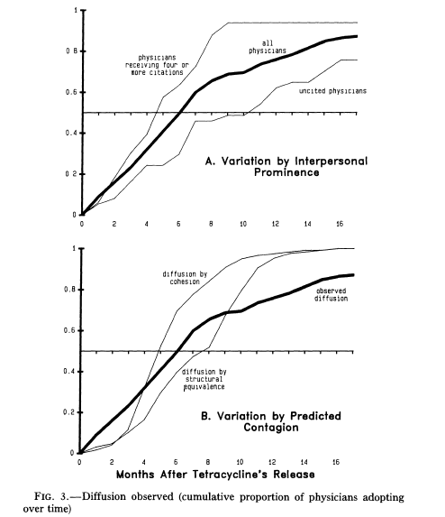
Cumulative Adoption Results
Diffusion by Cohesion:
  Adoption pattern where ego adopts after alter adopts
Diffusion by Structural Equivalence:
  Adoption pattern when ego adopts after peers adopt
  In both cases rate of adoption early on is higher than expected by contagion
  Contagion is not the only process at work
  High early adoption rate indicative of diffusion without contagion

Slide 6
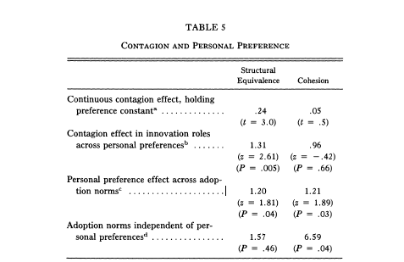
Results
Cohesion:
  Tie between ego and alter
Structural Equivalence:
  Euclidean distance between ego and alter (d_{ij}), i.e. how similar their patterns of ties are to others in the network

Slide 7
Results
Results from regressions:
  No evidence of contagion from advisors and discussion partners
  Strong evidence of diffusion between month in which peers adopted (structurally equivalent doctors) and ego adopting
  Personal factors determined adoption, i.e. predisposition to adopt
  Contagion independent of personal preference

Slide 8
Implications
Diffusion not via contagion (adjacency) but equivalence
  Why? Relative standing competition. Do not want to be a late adopter.
Heterogeneity in predisposition to adopt leads to critical mass needed to get diffusion by equivalence to take off

